Slide 1

Lab 8 -The Big 3

Slide 2
ReadMe
Reminders
No lab next week
Lab 8 due Sunday, November 18th at 8pm
Project 4 due Monday, November 19th at 8pm
Agenda
Review - The Big Three
Worksheet
Lobster Exercise
Lab 8
Project Questions?

Slide 3
Dynamic Memory
Recall:
If we use dynamic memory, we have a responsibility to clean up that memory when we’re done!
Example:
int num[] = new int[5];
delete[] num;
OR
int num = new int(5);
delete num;
Remember to use the correct syntax for deleting an array of items vs. a single item!

Slide 4
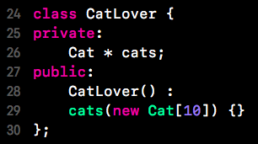
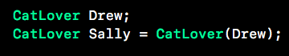










What happens when a class manages dynamic memory?
But what happens when we set Sally = CatLover(Drew)?
The Heap
When this constructor runs, “cats” points to a new array of Cats on the heap

Slide 5
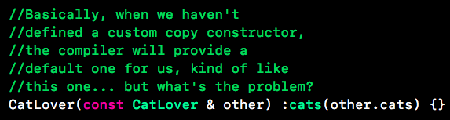

What happens when a class manages dynamic memory?
Compiler assumes we want an exact copy of each member variable… is that really what we want here?

Slide 6
What happens when a class manages dynamic memory?
Sally gets to share Drew’s cats!
The Heap
No copy constructor defined here, so the compiler provides a default copy constructor for Cat, which does a member to member copy… meaning the cats on the heap don’t get copied, just the pointer to them!
The Stack
Drew
cats
Sally
cats

Slide 7

Shallow Copy VS Deep Copy
The Heap
Shallow Copy
The Stack
Drew
cats
Sally
cats
The Heap
Deep Copy
The Stack
Drew
cats
Sally
cats

Slide 8
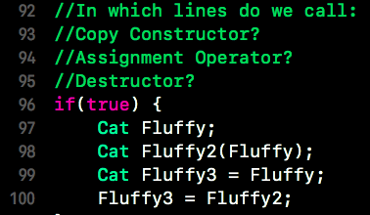
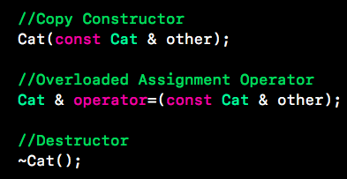

The Big Three
Copy Constructor
Initializes an object by making it a “copy” of another object
Assignment Operator
Assigns an already initialized object to be equal to another object
Destructor
Gets an object’s affairs in order before it is destroyed
When does my class need The Big Three?
(Probably whenever you say “new”!)
1
2
3
“MEOW!”

Slide 9
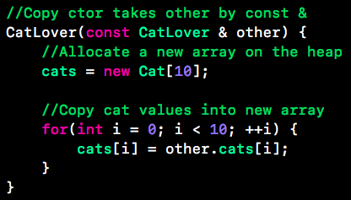

Writing a Copy Constructor
We need custom copy constructors to copy over objects’ dynamic memory
We will take in the other object by const reference
We will allocate new dynamic memory and copy over values

Slide 10
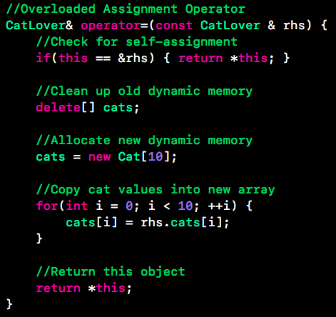
Writing an Overloaded Assignment Operator
Think about why copy constructors were necessary - assignment operators are necessary for almost the same reason!
Called when an already initialized object is assigned
Key tips:
Take parameter by const &
Check for self-assignment
Take care of old dynamic memory
Allocate new dynamic memory and copy values over
Return item being assigned into by reference
Why do we need to check for self-assignment?

Slide 11
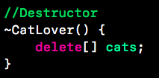

Writing a Destructor
All objects need to clean up their dynamic memory before they are destroyed - otherwise we will have no way to clean it up and we’ll leak a lot of memory.
Make sure you delete all of the dynamic memory the object manages.
Note: make your destructors virtual if there are subtypes involved!
The Heap
“MEOW!”

Slide 12
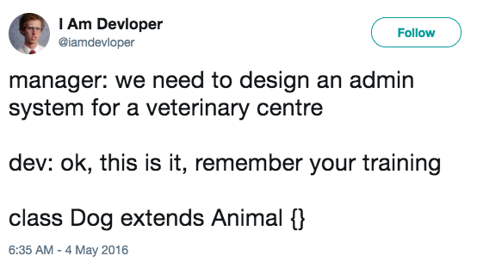
Worksheet!

Slide 13
Next...
Please go to:
https://lobster.eecs.umich.edu
And select from the EECS280 Code portion:
lab08_BigThree.cpp
Step through this with a partner for a few minutes

Slide 14

Moving On!
Lab 8
Project 4 Questions?

